Slide 1
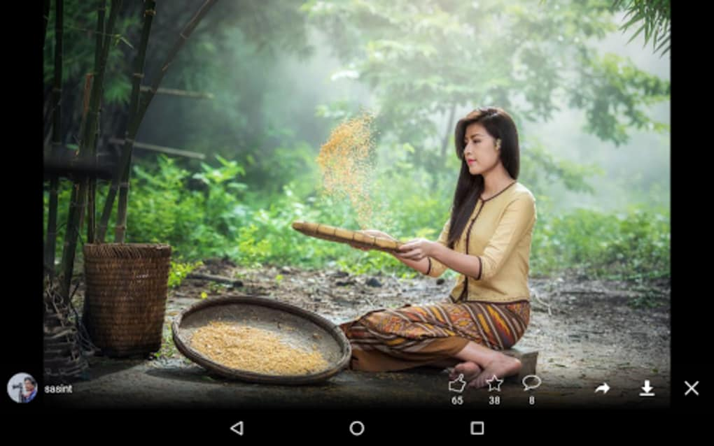
MY GIRL
This is the story of my girl means my girlfriend , best friend or soulmate whatever you can say . She behaves like a immature child front of me .She is very mature for the whole world and she is also an IITian still when it comes to me she behaves like a child .And I love her childish behaviour a lot.
I LOVE YOU
My baby

